Slide 1
Cryptocurrency
Pairs Trading Strategy
JIAWEI XU 10030027556

Slide 2
Key Concept
The fundamental idea of pairs trading is taking a market neutral position and using it to exploit an equilibrium between two assets.

Slide 3
Introduction
The assumption in the pairs strategy is that two correlated assets will drift in and out of an equilibrium and a position is open when the pair is out of an equilibrium and closed when the assets return to an equilibrium. Relying on the strong correlation that the two securities will maintain a specified correlation is the key to the strategy.

Slide 4
Two Key Mathematical Components
Producing the signal
Identifying the tradable asset pair

Slide 5
Tradable asset pair ETH - StETH
ETH
stETH
"Staked" or deposited ETH and locked up in beacon chain
Functions somewhat like an IOU
Cryptocurrency for blockchain-based platform Ethereum
Ethereum is the foundation for many emerging technological advances.

Slide 6
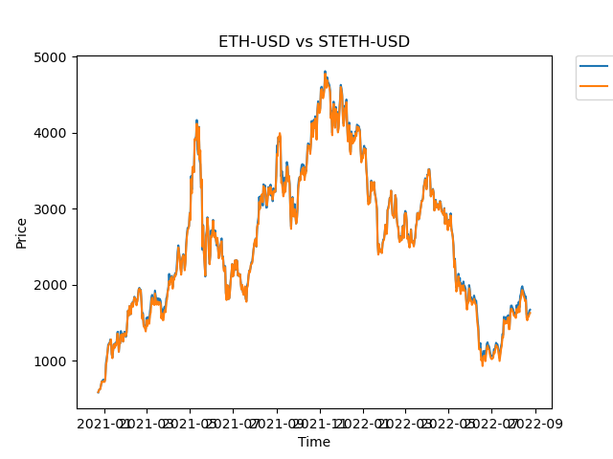
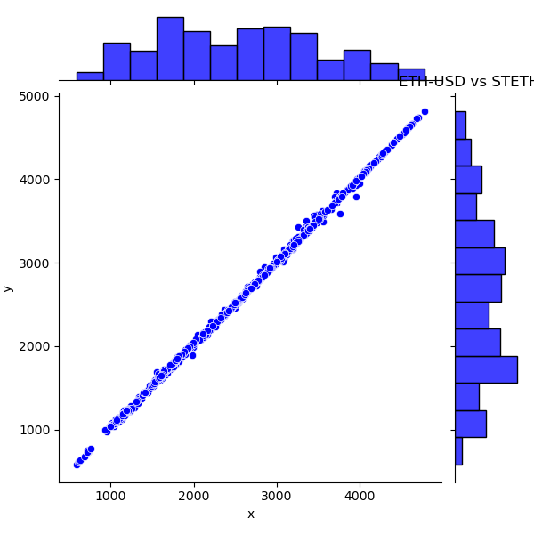
Tradable asset pair ETH - StETH
The right diagram shows a high positive correlation.

Slide 7
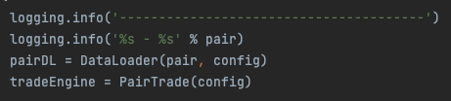
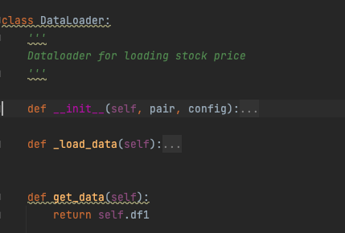
Code Snippet
DataLoader
Wrapper of YFinance

Slide 8
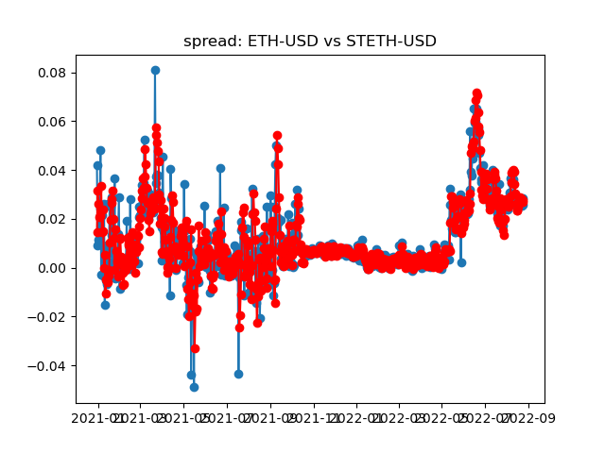
Spread
Spread
Blue dot
Calculated as log(ETH/stETH)
Mean Spread
Red dot
Estimated by SLR with minimum mean square error

Slide 9
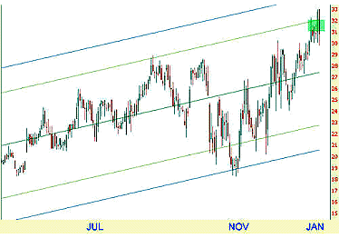
Regression Channel
Mean Spread
A rolling mean spread is calculated based on a rolling regression channel which minimize the MSE.
Rolling window is set to be 7 to lower the risk in case of long period holding.

Slide 10
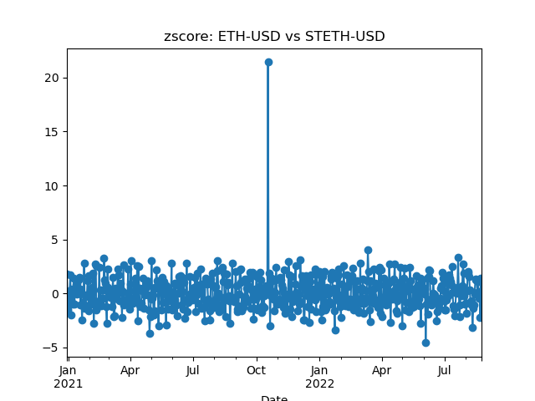
Trading Signal
zScore
Z = (x-u)/std
Entry Score & Exit Score
Long Entry: -1
Short Entry: 1
Exit Score: 0

Slide 11
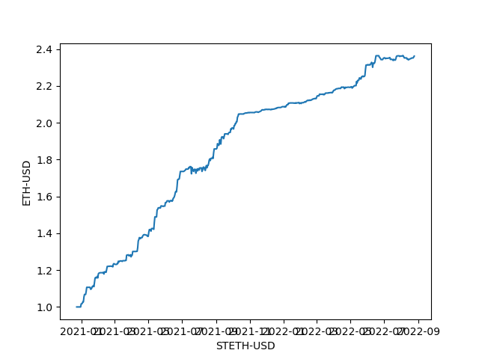
Equity Curve (Amazing!)
ETH-USD - STETH-USD
Total Annunal Return = 56.3483
CAGR = 42.7058
Sharpe Ratio = 4.6900
Stable and almost no drawdown !!!

Slide 12
—White Reality Check
To see if the returns were obtained by chance or not.

Slide 13
White Reality Check
White's Reality Check (WRC) was invented and patented by economist H. White, a professor at the University of California at San Diego.
As it was pointed out it uses the bootstrap method to derive a sampling distribution that is appropriate to test the statistical significance of the best rule found by data mining.

Slide 14
White Reality Check
Let's take a highly simplified example to explain the procedure WRC uses.
Suppose the data miner has back tested only two rules (N = 2) over 10 days.
I will refer to the rules as R1 and R2.
over the 10-day period R1 earned a mean daily return of 1 percent,
whereas R2 earned a mean daily return of 2 percent.

Slide 15
White Reality Check
The data miner picks rule 2 as the best performer, but then wonders, as one should, if the 2 percent was the result of data-mining bias and if its true expected return is actually zero.
To generate the sampling distribution that would be appropriate for this data-mining venture, the following steps are taken:

Slide 16
White Reality Check
(1) The rules were tested over 10 trading days.
Thus 10 slips of paper are used to represent each date of trading.
They are numbered from 1 through 10 and placed in a bucket for sampling.

Slide 17
White Reality Check
(2) The slips of paper are then sampled with replacement 10 times.
Each time a date is withdrawn from the bucket, the date number is noted.
The number of samplings is 10 because that was the length of each rule's performance history.
This is a requirement of the Bootstrap Theorem.
Suppose the following dates were selected: 5, 3, 5, 5, 7, 2, 5, 8, 1, 2.

Slide 18
White Reality Check
(3) Using the dates obtained in step 2, a pseudo-track record based on the actual daily returns associated with these dates is created for R1.
This procedure is also carried out for R2.
We now have a randomly generated performance history of length 10 for each rule.

Slide 19
White Reality Check
(4) A. Recall that our goal is to generate the sampling distribution for the best-performing rule in a universe of rules which have expected returns equal to zero.
Because it is possible (in fact, it is our hope) that at least one of the rules tested has an expected return greater than zero, the raw historical returns of R1 and R2 must be adjusted to have mean returns of zero.
To accomplish this, WRC determines the mean daily return for each rule tested and subtracts this amount from each individual daily return

Slide 20
White Reality Check
(4) B. In this example, R1's mean daily return is 1 percent and R2's is 2 percent.
Thus 1 percent is deducted from each of R1’s daily returns whereas 2 percent is deducted from each of R2's daily returns.
This has the effect of shifting the distribution of daily returns for each rule so that it is centered over zero. These adjusted daily returns are now used.

Slide 21
White Reality Check
(5) The adjusted returns of R 1 for days 5, 3, 5, 5, 7, 2, 5, 8, 1, 2 are averaged. The adjusted returns for R2 for these days are also averaged.

Slide 22
White Reality Check
(6) The larger of these two mean values is held aside as the first value used to form the sampling distribution of the maximum mean return of N rules. In this case N = 2.

Slide 23
White Reality Check
(7) Steps 2 through 6 are repeated many times (e.g., 500 or more times).

Slide 24
White Reality Check
(8) The sampling distribution of the statistic, maximum mean return in a universe of N (2) rules whose expected returns are zero is formed from these 500 values.

Slide 25
White Reality Check
(9) With the sampling distribution now in hand, the p-value can be computed.

Slide 26
White Reality Check
(10) The p-value would simply be the fraction of the 500 values obtained at step 7 that exceed the average return of the tested rule. (See Chapter 5 for the procedure.)

Slide 27
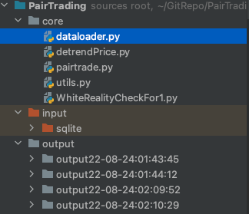
Code Structure
Core: Trading Engine
Input: SQL base
Output: Temporary csv and plots

Slide 28
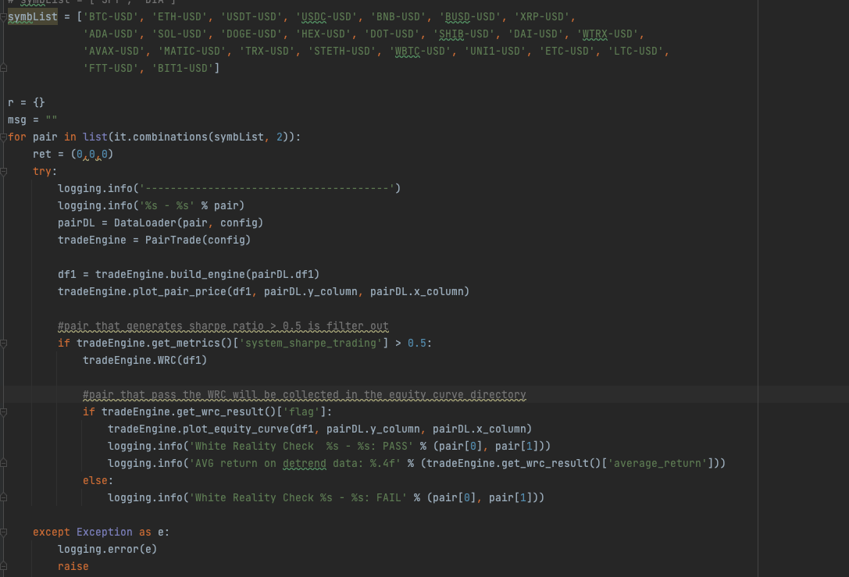
Code Structure
Main function

Slide 29
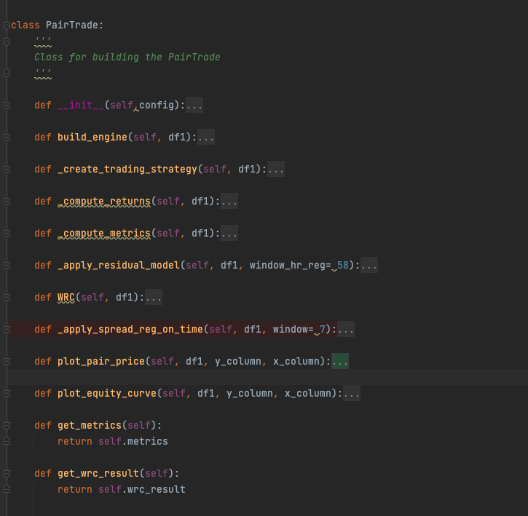
Code Structure
Pair Trade Object

Slide 30
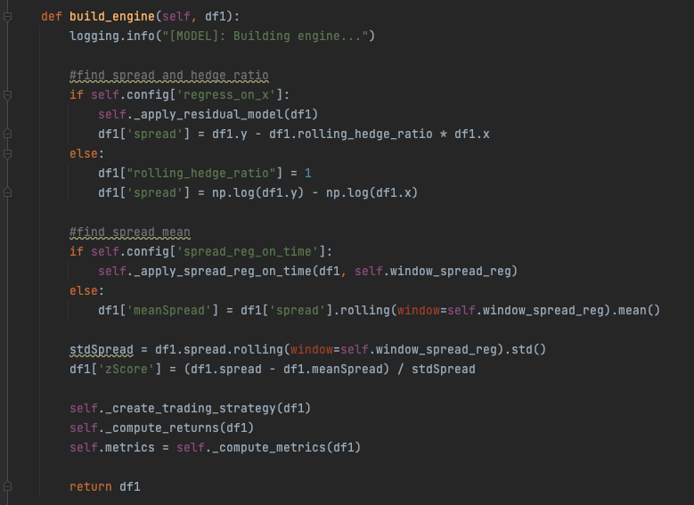
Code Structure
Regress_on_x : if true then apply regression on y wrt to x, and find out the rolling hedge ratio, then calculate the spread with y, x and hedge ratio, otherwise assigned ratio with 1.
Spread_reg_on_time: if true then apply regression on spread wrt to time, and find out the mean spread.
Calculated spread std.
Generate trading signals .
Compute returns && metrics

Slide 31
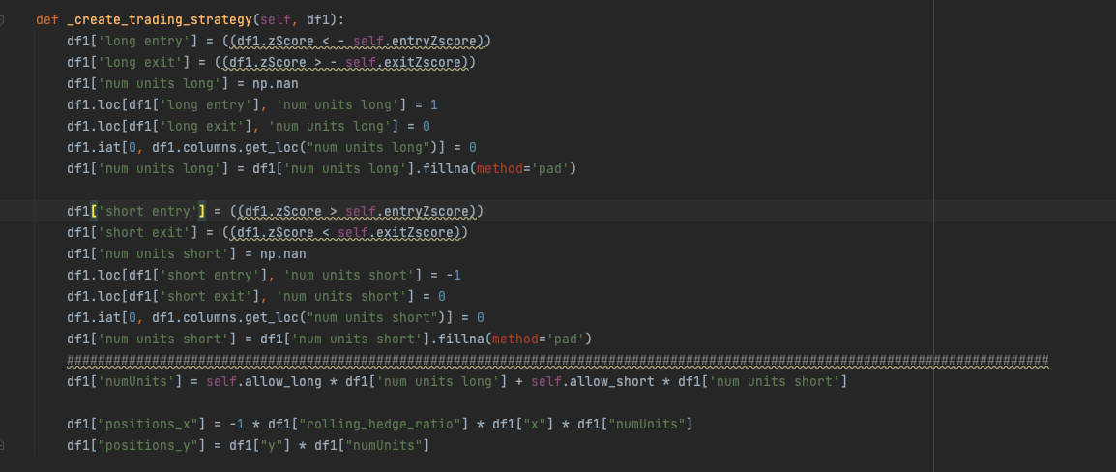
Trading Strategy

Slide 32
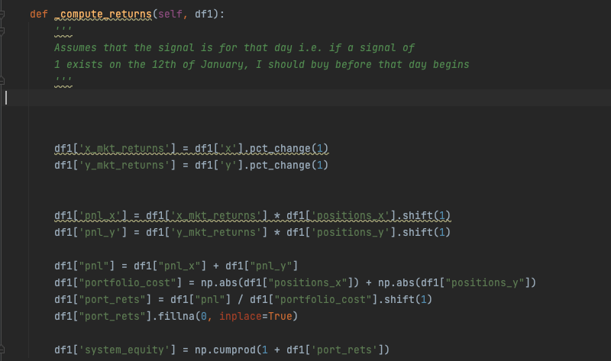
Compute Returns

Slide 33
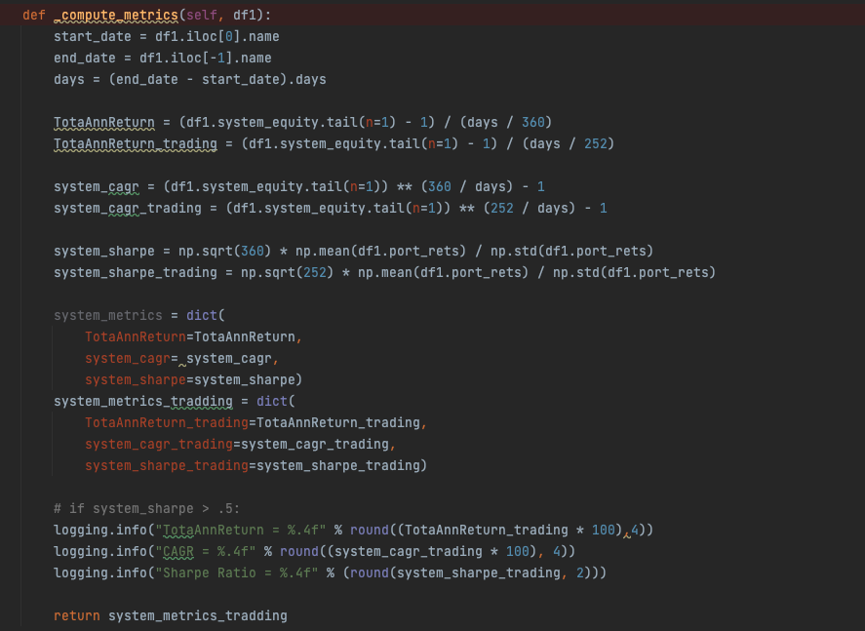
Compute Metrics

Slide 34
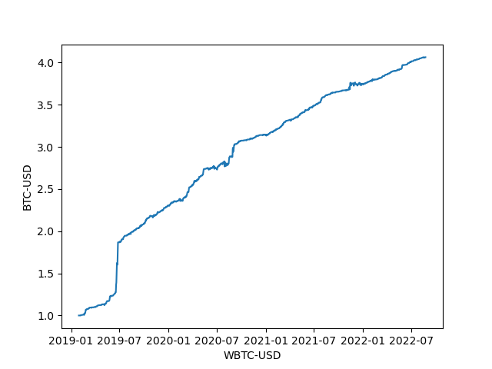
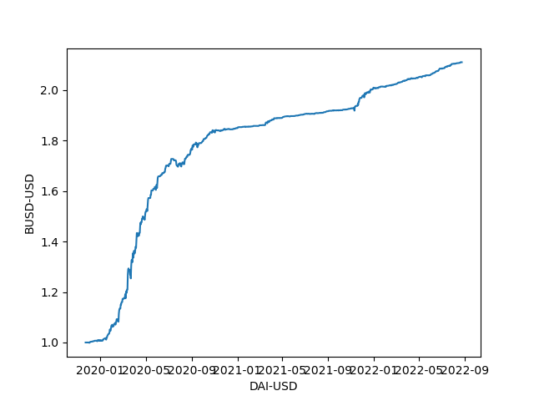
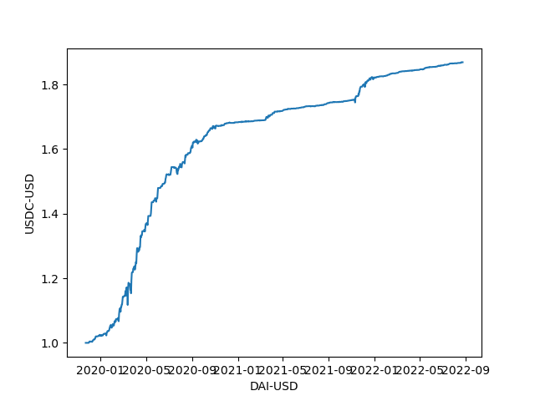
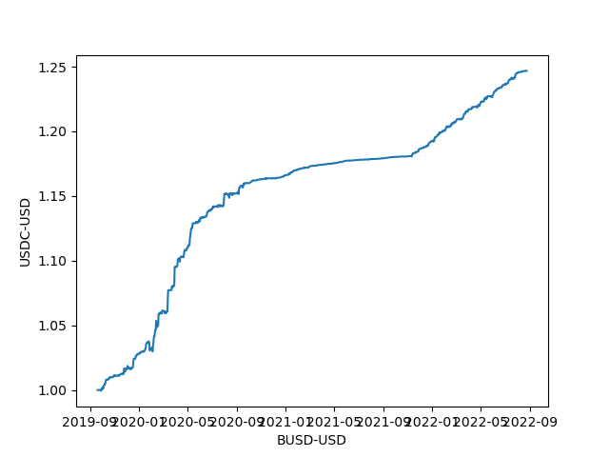
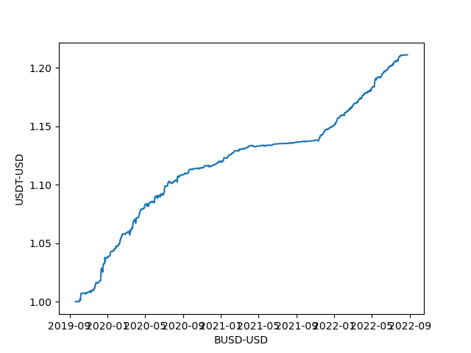
Amazing Results
Picking Criteria: Sharpe > 0.5 && Pass White Reality Check
Most are stable coin pairs or same family coin (BTC VS WBTC, ETH VS stETH)

Slide 35
Thanks!

